Slide 1
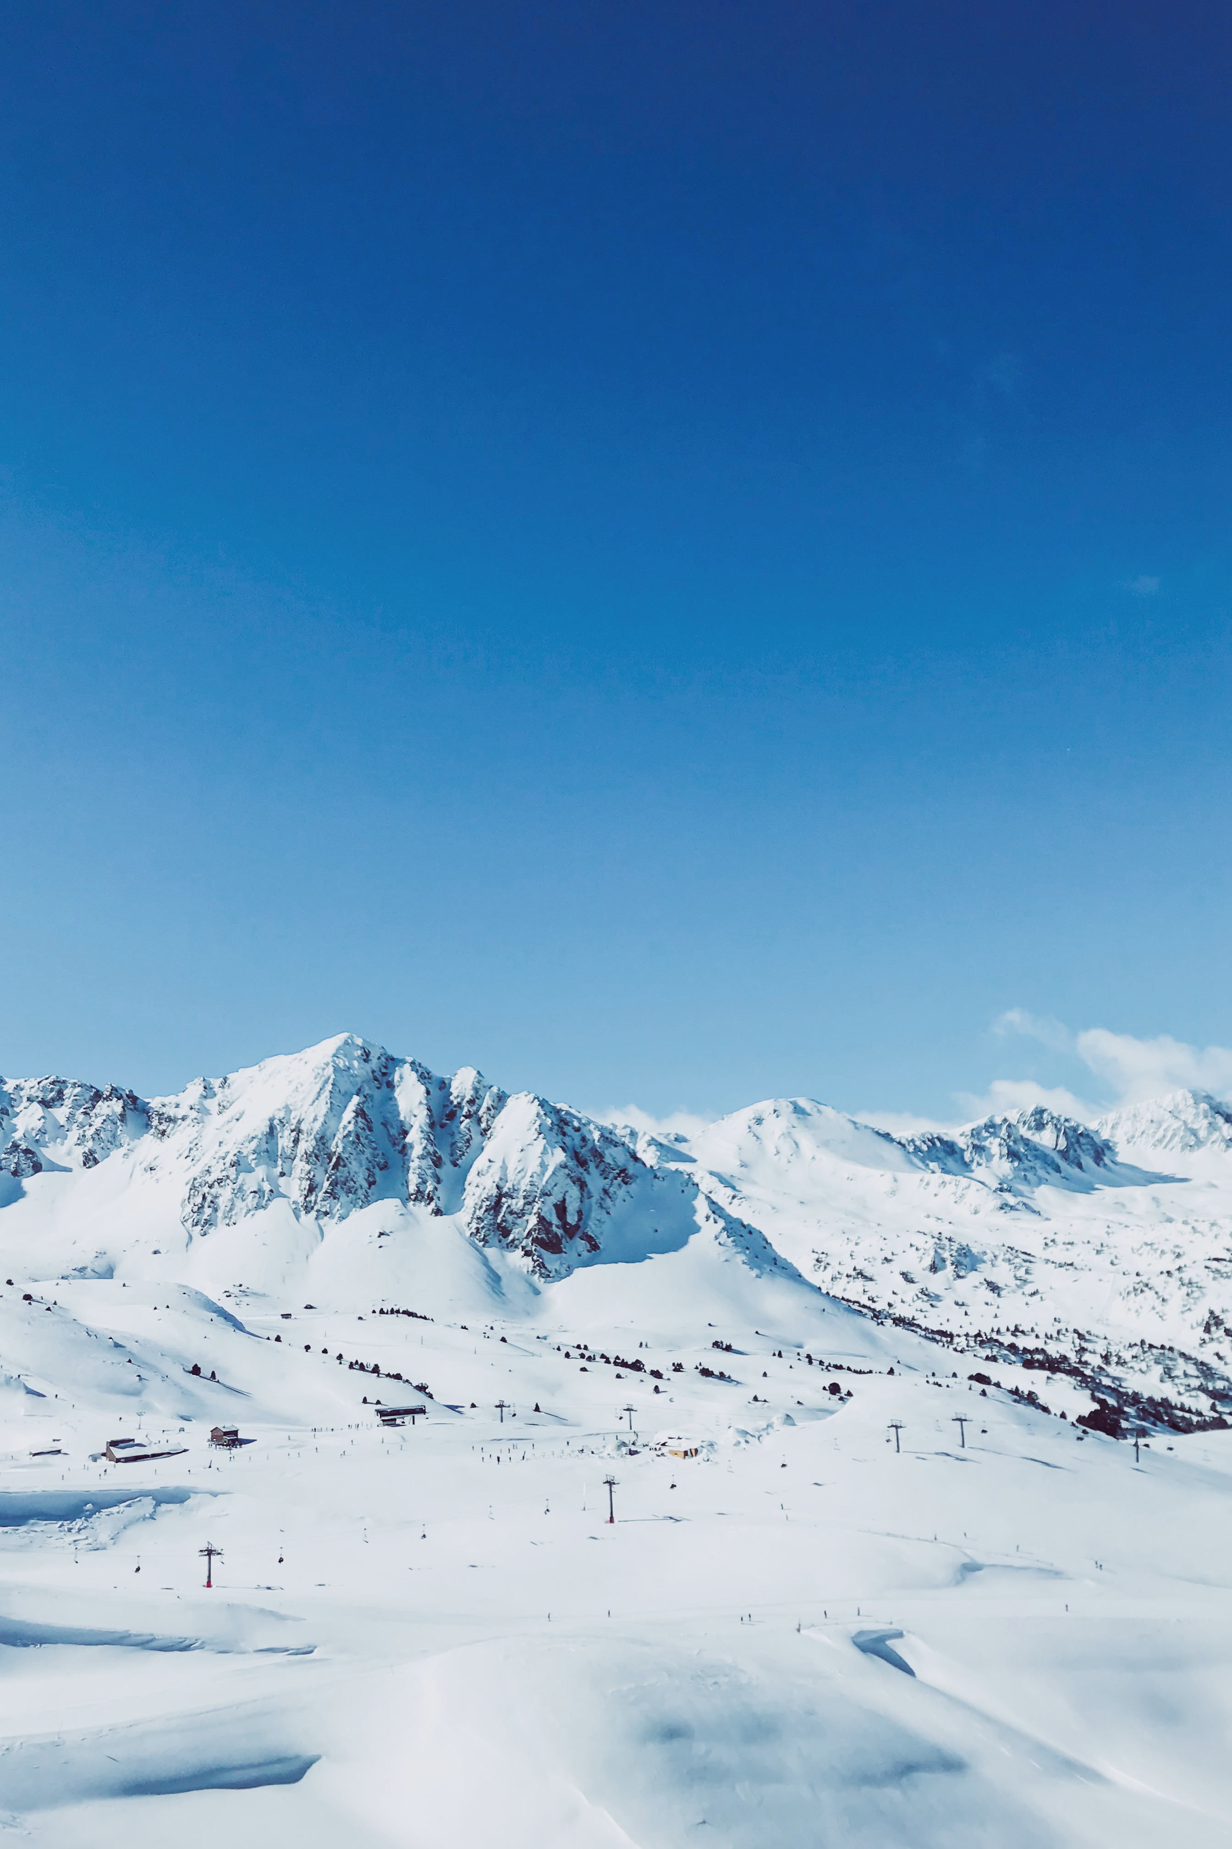
Big Mountain Ski Resort insights and recommendations
by Carrie-Cate Jenkins
July 18, 2022
Notes:
Line spacing + Page numbers

Slide 2
Agenda
01 Problem Identification
02 Recommendations and key findings
03 Modeling results and analysis
04 Summary

Slide 3
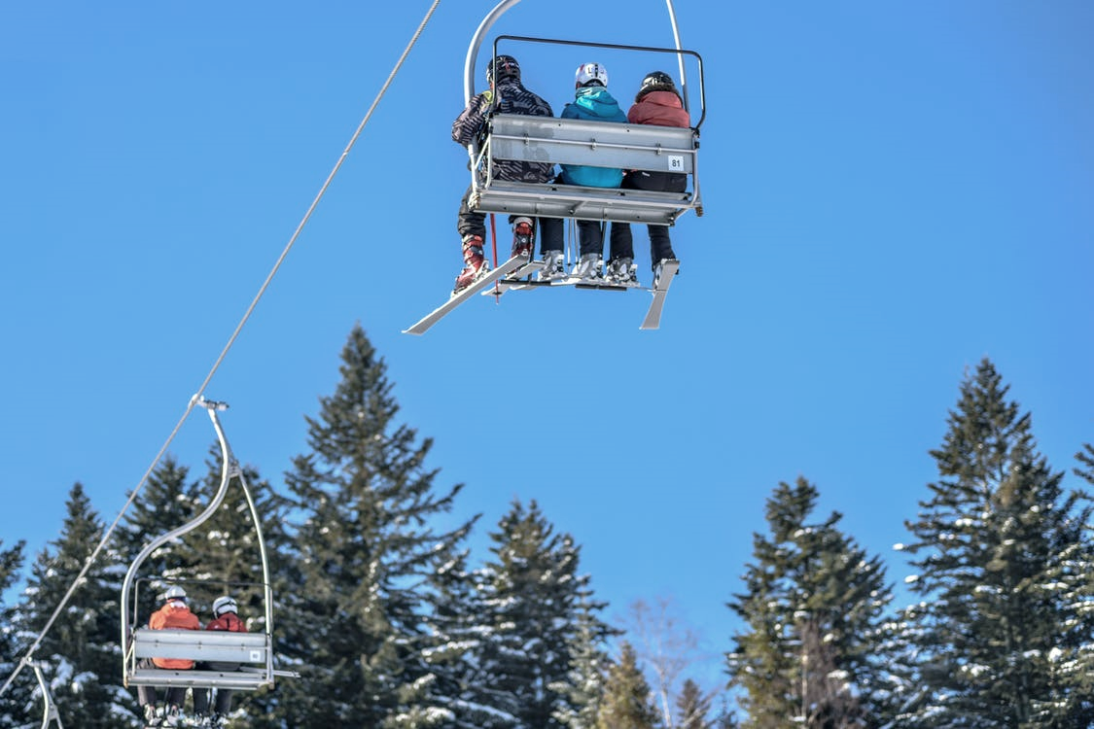
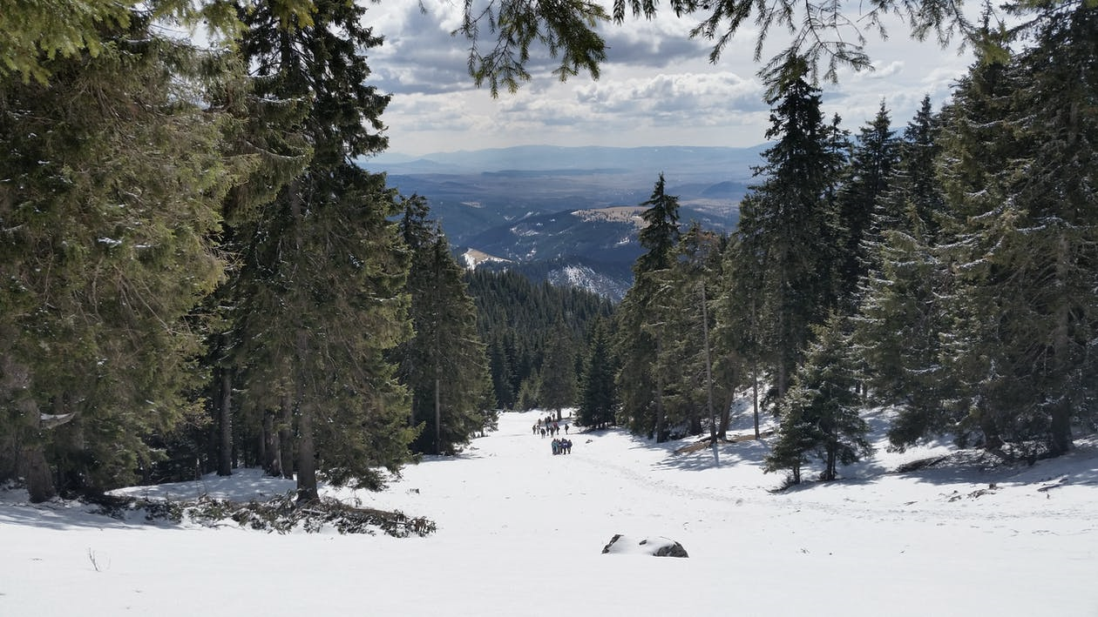
Problem Identification
01
Big Mountain Resort offers access to 105 trails, spectacular views of Glacier National Park and Flathead National Forest, and hosts about 350,000 visitors each year. The resort has remarkable facilities, including a newly installed additional chair lift.
What opportunities exist for the resort to make the most of their current facilities, set the best possible ticket prices, ensure that new investments pay off, and plan for a profitable future?

Slide 4
Goals:
Best use of resort features:
Set ticket price:
Decrease costs:
Compare Big Mountain to other resorts as far as features and prices
Determine a ticket price supported by this comparison and increase profits by the end of the season
Increase profit by at least $1.54 million annually to pay for the new chair lift
Increase profit margin above the current 9.2% within the next year
Examine whether there are areas the resort could cut any expenses without decreasing income
Identify the most profitable and least profitable resort features
Plan for future changes at the resort

Slide 5
Key findings
02
& Recommendations

Slide 6
increase ticket price to $83
Recommendation:
Supported by the data
Increases annual income by $3,500,000
Covers cost of the new chair lift
And allows for new investments

Slide 7
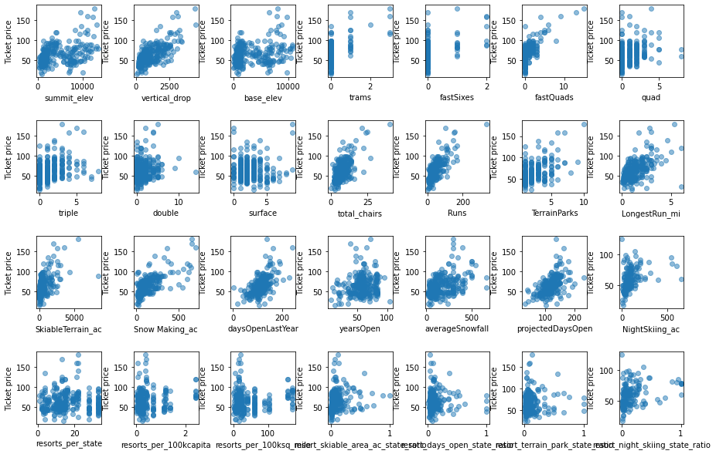
Possible correlations between various resort features and ticket price

Slide 8
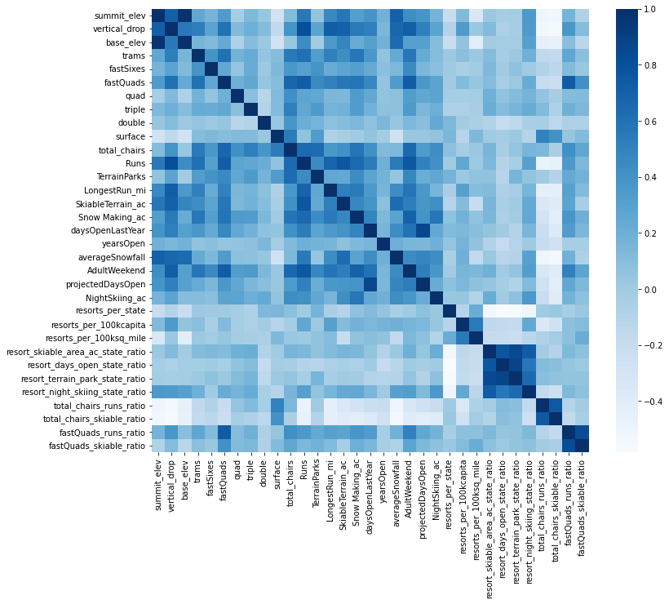
Growth by sector

Slide 9
Modeling results
03
and analysis

Slide 10
The modeling process:
Big Mountain’s current ticket price
Model from the data
Recommended ticket price
Big Mountain vs others
$81
?
!!!
=
-
$63.81
$82.99
$85+
The most important features
Average price of other resorts
With future additions
Which features are most valuable?
Identifying which features most affect ticket price allows us to begin to analyze the data and build a model
How does Big Mountain compare?
Big Mountain Resort is on the higher end compared to other resorts for nearly all major features that seem to correlate most with ticket price.
Build ticket
price model
Starting with a simple mean ticket price, we progressed to a linear regression model before choosing a random forest model to go forward with this analysis
Recommendations and future planning
The model suggests a ticket price of about $83. Features comparisons also support increasing price. Certain additions could further increase ticket price in the future.

Slide 11
Pre-model: Using the mean to suggest ticket price
Results: $63.81 with an error margin of $19
This suggests that the ideal ticket price for a resort be somewhere
between $44.81 and $82.81.
A large range is not very useful.
Does not reflect any features of individual resorts
Provides a baseline against which to compare future models

Slide 12
Model A: Linear Regression Model
Lessens error compared to the mean from $19-$9
A smaller range mean that this model is more useful than using the mean alone.
Accounts for 70%-80% of variability
This model also does not weigh each feature to give a detailed estimate,
and we will see that the next model shows less error and less variability.
Highlights 4 most important features:
Distance of vertical drop
Snow-making acres
Number of fast quads
Number of runs

Slide 13
Model B: Random Forest Model
Results: $95.87 with an error margin of $9
This suggests that the ideal ticket price be between $86.87 and $104.87.
Mean absolute error of $9.53 (better than the linear regression model or the mean)
A smaller range is more useful than any earlier methods.
This model takes each resort feature into account to give a more detailed and accurate estimate.
Highlights 4 most important features:
Number of fast quads
Number of runs
Snow-making acres
Distance of vertical drop

Slide 14
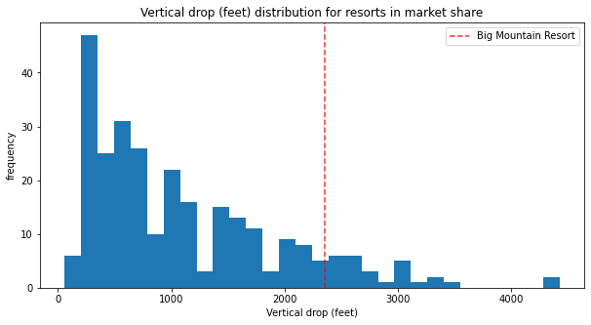
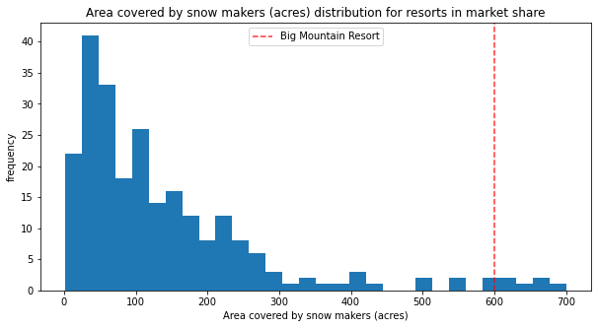
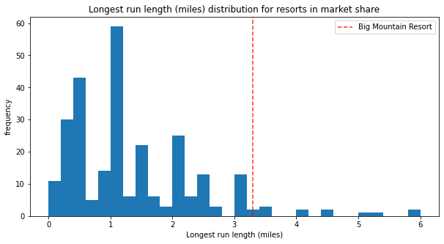
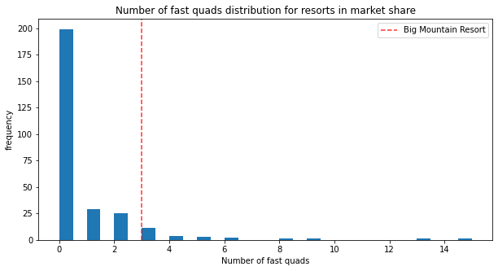
Four most important features: Big Mountain Resort in market context

Slide 15
Summary
04
Ticket prices should be raised | Big Mountain Resort offers more than most resorts in the market
Investing in certain features supports higher ticket prices | Even small ticket price increases greatly increase annual income
Increases in income can cover additional future investments | The future of the resort is profitable and supported by evidence

Slide 16
Future plans:
Improvements
Add one additional run
Increase vertical drop by 150 feet
Additional new chair lift
Would support additional ticket increase by $1.99
Annual income increase by $3, 474, 000
Use the model going forward
Predict the effects of any feature change or addition
Keep data up to date so the model reflects the current market
Estimate ideal ticket price based on any changes at Big Mountain or changes in the market
Cutting costs?
Up to one run could be closed without decreasing ticket cost
More research is necessary to determine the affect of changes on resort budget

Slide 17
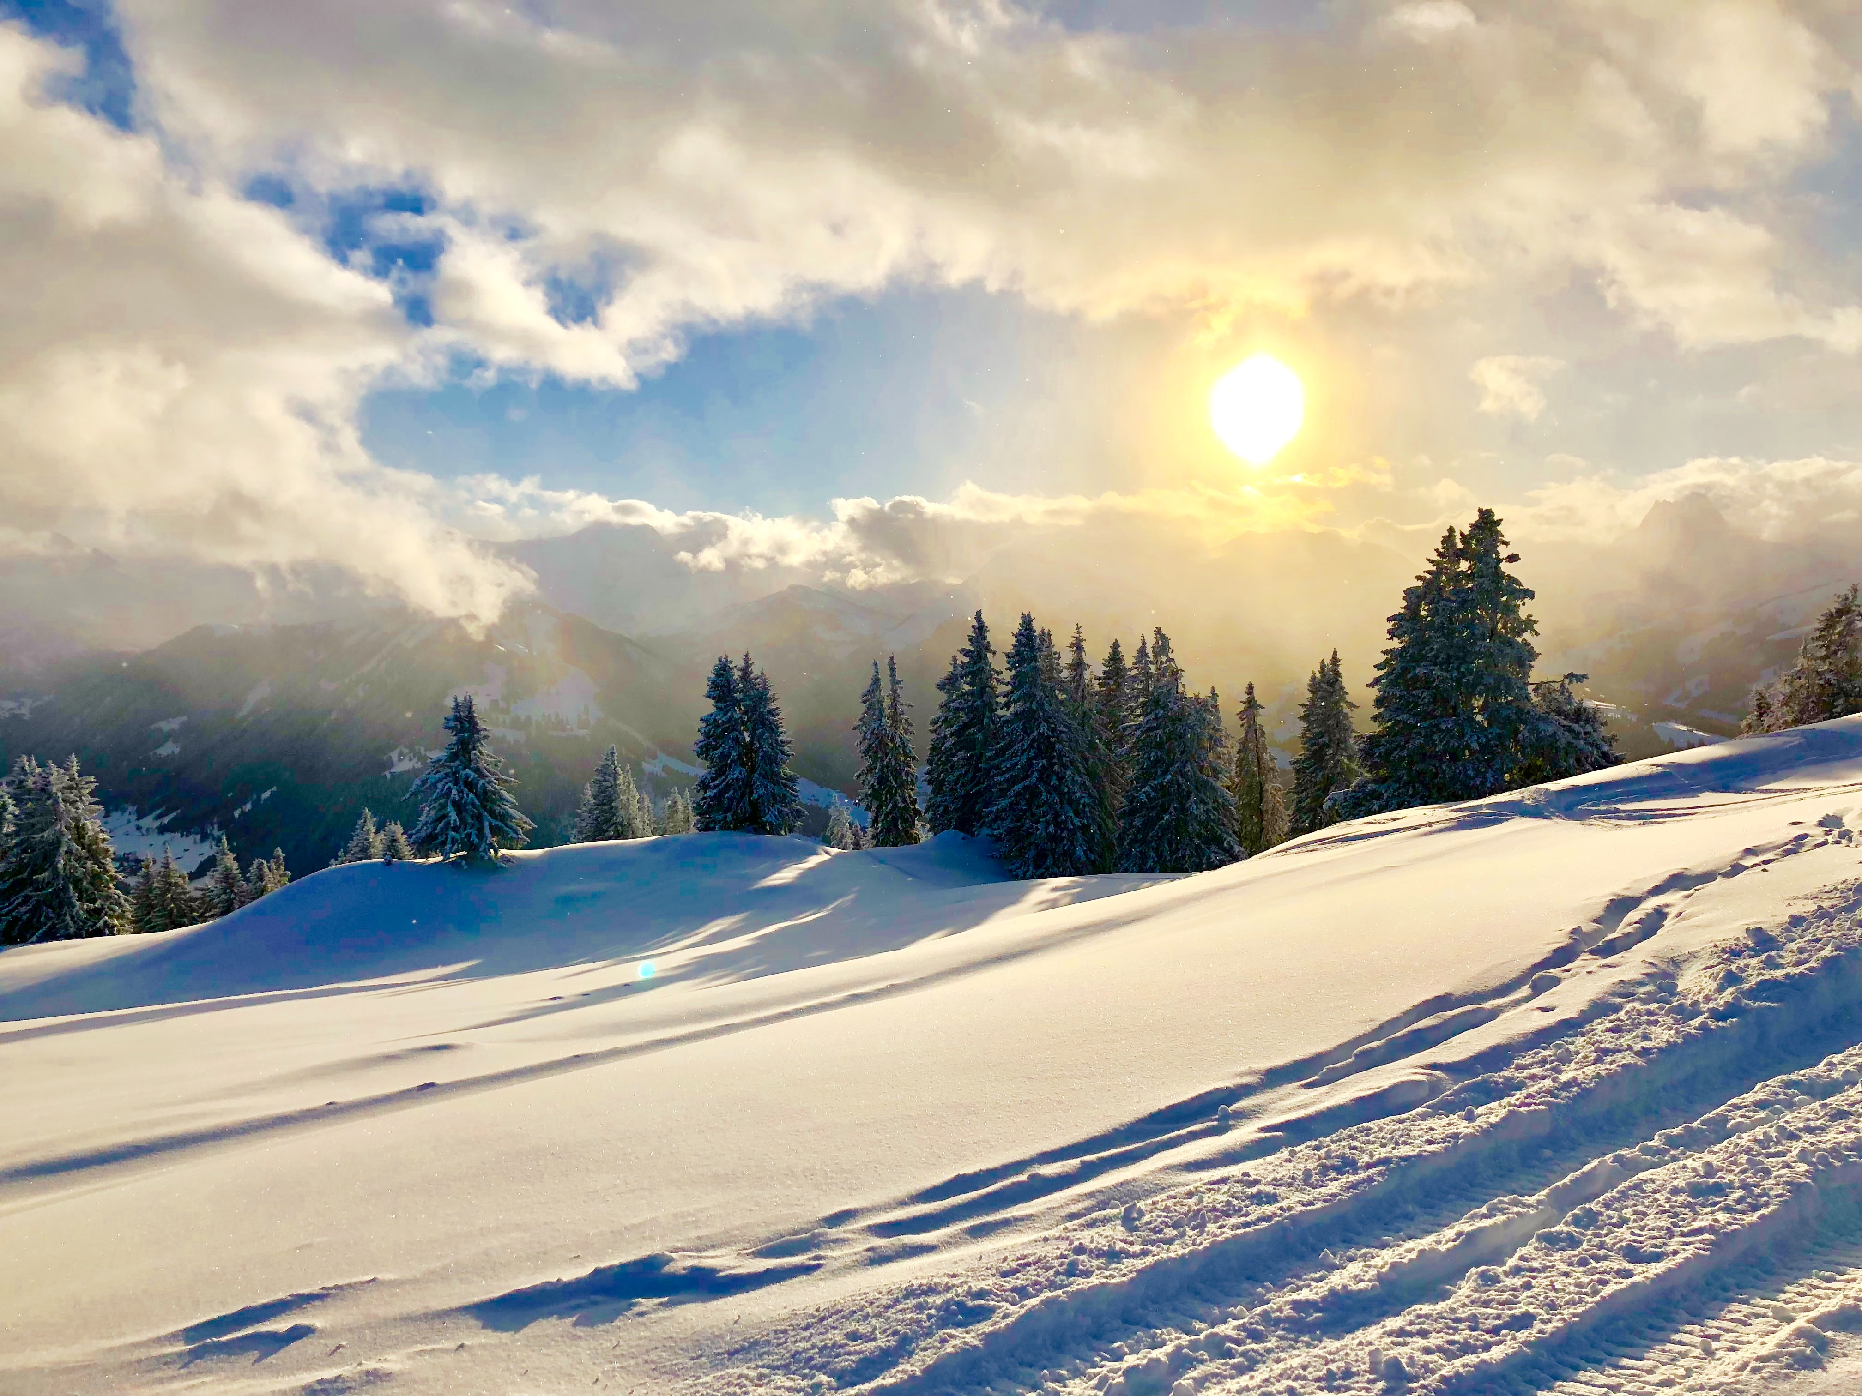
Looking ahead…
Using the models and functions we have created, Big Mountain Resort can determine which features to invest in, how to adjust ticket prices accordingly, and how these changes could affect resort income. Using these data-supported strategies, the future of the resort will be exciting, expansive, and profitable.

